Slide 1
Introduction to Java
AIM:
To equip students with fundamentals of Java Programming.

Slide 2
Introduction to Java
Objectives:
The Objectives of this module are:
Explain the features in java
Explain classes and objects
Illustrate various operators in Java
Illustrate keywords, variables and data types in Java
Explain the use of string
Demonstrate different control statements in Java
Discuss declaration, definition and calling of methods in Java
Describe arrays in java

Slide 3
Introduction to Java
Outcome:
At the end of this module, you are expected to:
Differentiate between the features of Java and other language.
Explain use of JRE and JDK, byte code and JVM.
Write simple Java program.
Describe the basics of classes and objects.
Describe the role of operators in java with example.
Manipulation of String in Java.
Develop programs to demonstrate different operators in Java.
Create a program to illustrate the concept of passing an array to method.

Slide 4
Introduction to Java
Table of Contents
Introduction to Java
Installation of Java
Data types
Operators
Access specifiers
Typecasting
Control Statement
Methods
Arrays

Slide 5
Introduction to Java
Introduction to java
James Gosling, Mike Sheridan, and Patrick Naughton initiated the Java language project in June 1991.
Originally designed for small, embedded systems in electronic appliances like set-top boxes.
Firstly, it was called "Greentalk" by James Gosling and file extension was .gt.
After that, it was called Oak and was developed as a part of the Green project.

Slide 6
Introduction to Java
Why Java is important?
Trouble with C/C++ is that they are not portable and not platform independent language.
Emergence of World Wide Web, which demanded portable language.
Portable and security necessitated the invention of java.

Slide 7
Introduction to Java
What is Java?
A general purpose object oriented language.
Write once run anywhere.
Automatic memory management.
Designed to easy web/ internet application.
Widespread acceptance.

Slide 8
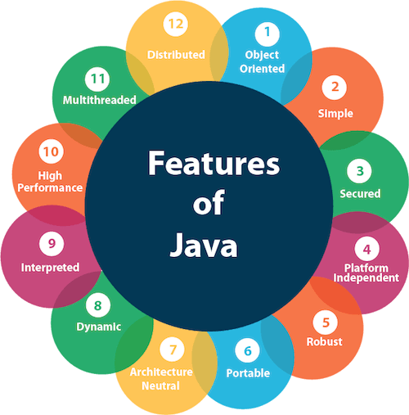
Introduction to Java
Features of Java
Simple
Object-Oriented
Portable
Platform independent
Secured
Robust
Architecture neutral
Interpreted
High Performance
Multithreaded
Distributed
Dynamic

Slide 9
Introduction to Java
Installation of Java
Step 1: Download JDK
Step 2: Install JDK and JRE
Step 3: Include JDK's "bin" Directory in the PATH
Step 4: Verify the JDK Installation
Step 5: Write a Hello-World Java Program
Step 6: Compile and Run the Hello-World Java Program

Slide 10
Introduction to Java
Java Virtual Machine (JVM)
JVM (Java Virtual Machine) is an abstract machine.
It is a specification that provides runtime environment in which java bytecode can be executed.
The JVM performs following operation:
Loads code
Verifies code
Executes code
Provides runtime environment

Slide 11
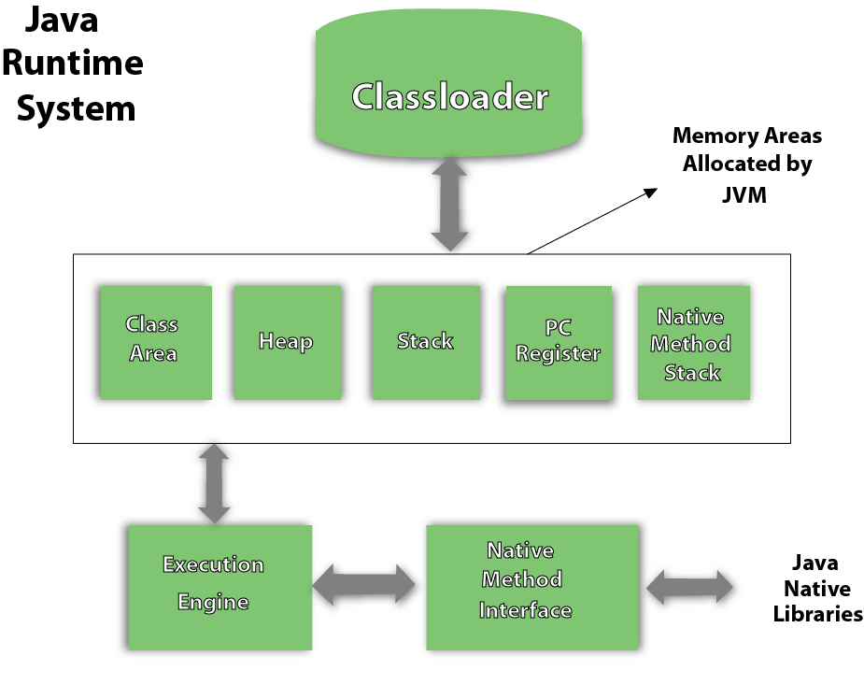
Introduction to Java
JVM Architecture

Slide 12
Introduction to Java
Byte Code
Byte codes are the machine language of the Java virtual machine.
When a JVM loads a class file, it gets one stream of byte codes for each method in the class.
Byte code streams are stored in the method area of JVM.
Source Code
Java Virtual Machine (JVM)
Java Complier
Operating System (OS)
Byte Code

Slide 13
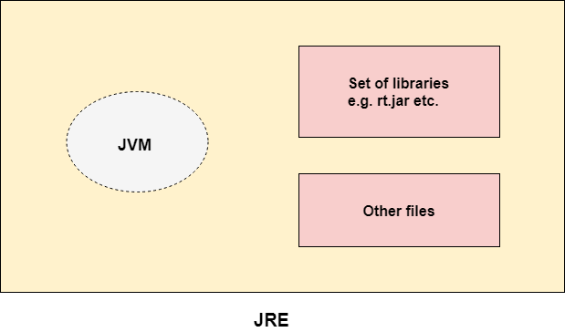
Introduction to Java
Java Runtime Environment (JRE)
The Java Runtime Environment is a set of software tools which are used for developing java applications.
It is used to provide runtime environment.

Slide 14
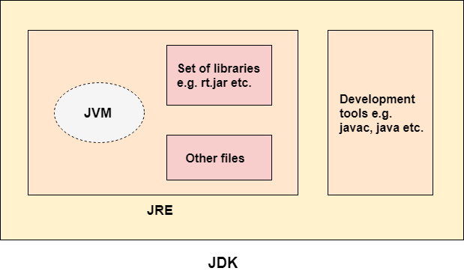
Introduction to Java
Java Development Kit (JDK)
The Java Development Kit (JDK) is a software development environment which is used to develop java applications and applets.
It contains JRE + development tools.

Slide 15
Introduction to Java
Simple Java Program:
import java.util.*
public class Simple
{
public static void main(String args[])
{
System.out.println(“Welcome");
}
}
Compilation: javac Simple.java
Execution: java Simple

Slide 16
Introduction to Java
Self Assessment Questions
Select all the features of Java:
Object oriented
Compiled
Memory management
Multiple inheritance
Scripting language
Answer:

Slide 17
Introduction to Java
Self Assessment Questions
What is a Java compiler?
The part of Java that tells the computer to execute your code.
The resulting file when your source code is translated into machine code.
The part of Java that translates your source code into machine code.
The results of running a java program.
Answer:

Slide 18

Introduction to Java
Document Links
Topics | URL | Notes
Features of java | https://www.sitesbay.com/java/features-of-java | It gives detailed explanation of features of Java
Java installation | https://www3.ntu.edu.sg/home/ehchua/programming/howto/JDK_Howto.html | This link will provide installation guide for java in windows and mac OS
JRE,JDK,JVM | https://www.javatpoint.com/difference-between-jdk-jre-and-jvm | This link provides detailed view of java libraries and environment

Slide 19

Introduction to Java
Video Links
Topics | URL | Notes
Introduction to Java Installation of Java | https://www.youtube.com/watch?v=r59xYe3Vyks | It provide detailed explain for installing java.
JVM,JDK and JRE | https://www.youtube.com/watch?v=RYd_hagCiVk | It provide better to understanding in differences between JVM vs JRE vs JDK in java in one video

Slide 20

Identifier
It is a name given to a class, variable, constant or method.
Rules for Declaring a Legal Identifier:
Identifier must start with a letter, $, _. Cannot start with number.
After the first letter, contain numeric.
No Limit to the number of characters an identifier can contain.
Cannot use keyword in identifier name.
Identifiers are case-sensitive.

Slide 21
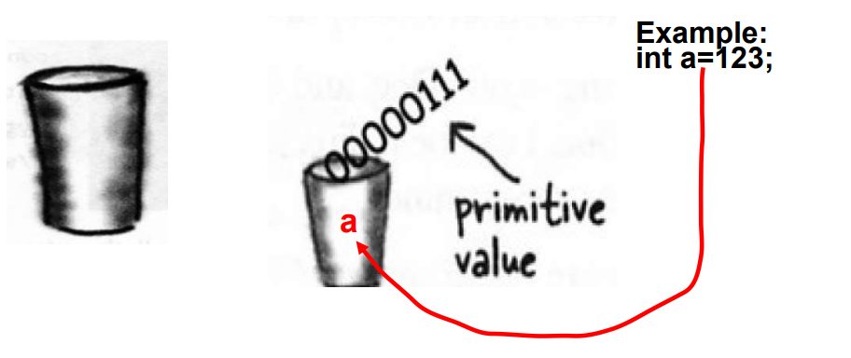
Variable
Variable definitions :A variable is just like a cup or container. It can hold something. It has a size and a type.
Variable: name of place in memory that can contain data
All variables have:
Data type → kind of data variable can contain
Name → identifier that refers to the variable
Value → the default or specified value
also called the literal of the statement
Semicolon
Remember: All java statements end with a semicolon!
e.g.
String s = “MC697”;
int count = 5;

Slide 22
Data Types in Java
Variable (Cup) can be of two type
✔Primitive Type
✔Reference Type
Primitive Type – Primitives are like the cups at the Coffee-House They come in different sizez
Reference type A Reference variable holds bits that represents a way to access an object. It doesn't hold the object itself, but it holds something like a pointer, or an address.different sizes and each has name like small , big, medium.

Slide 23
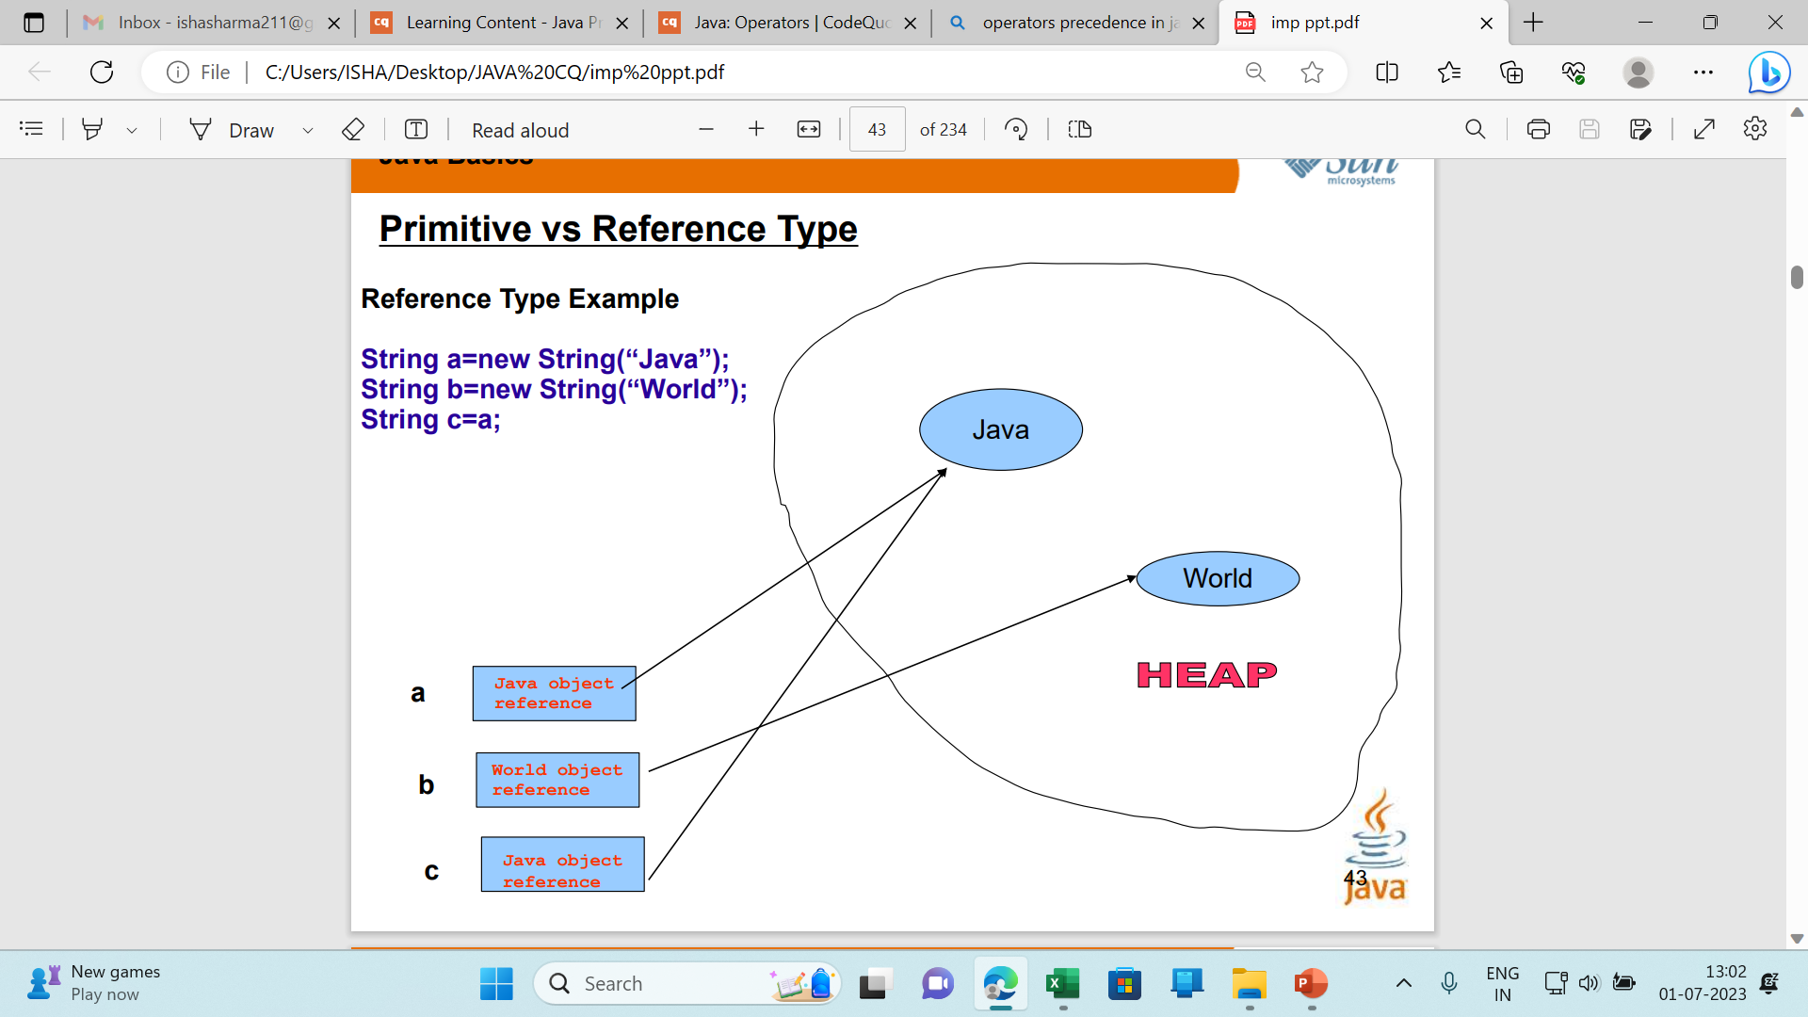
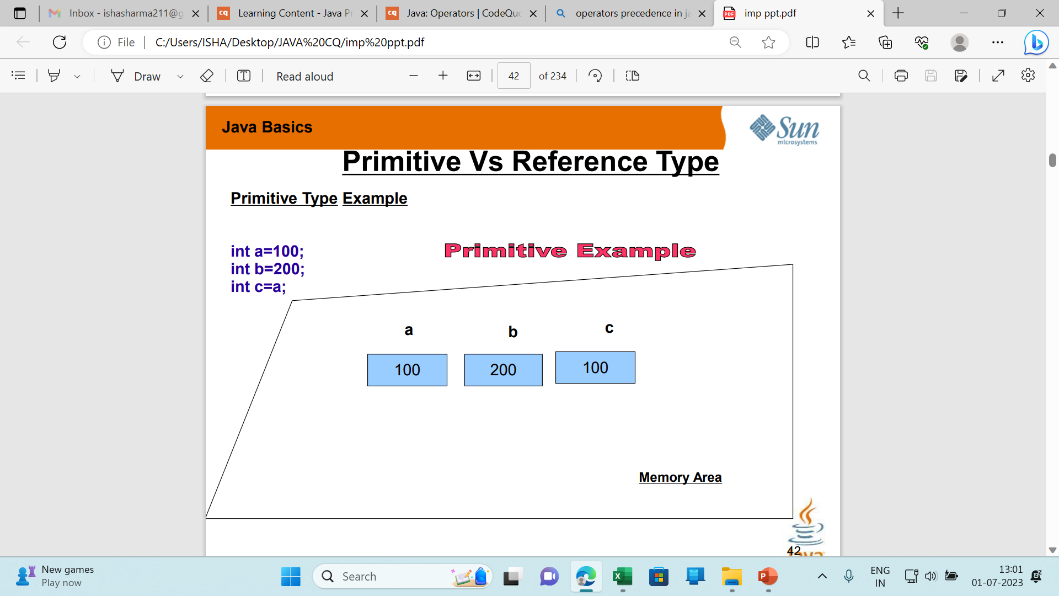

Slide 24
Using == with primitive type
Example
int a=100;
int b=100;
System.out.println(a==b);
//print true
Using == with reference type
Example:
String a=new String(“Hello”);
String b=new String(“Hello”);
System.out.println(a==b);
// false
Why ???
Answer is, The reference type checks address in this case , it return true if both address or references are same.
So HOW I COMPARE VALUES IN REFERENCE TYPE, BECAUSE == CHECKS ADDRESS NOT VALUE?
Answer is using equals() System.out.println(a.equals(b)); //return true

Slide 25
Introduction to Java
Data types in java
Data types specify the different sizes and values that can be stored in the variable.
There are two types of data types in Java:
Primitive data types: The primitive data types include Integer, Character, Boolean, and Floating Point.
Non-primitive data types: The non-primitive data types include Classes, Interfaces, and Arrays.

Slide 26
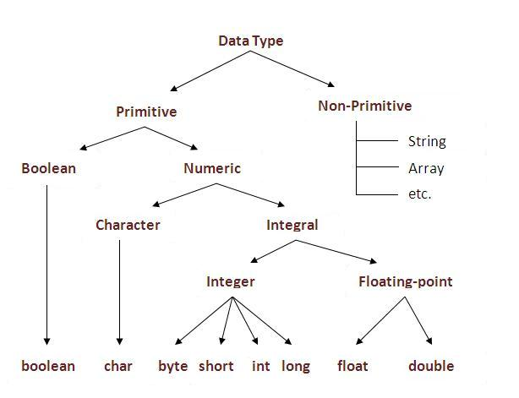
Introduction to Java
Primitive and Non primitive data types

Slide 27
JAVA Primitive Data Types-Strongly Typed-Statically Typed Language
Data Type | Width in bits | Range
byte | 8 bit signed integer | -128 to 127
short | 16 bit signed integer | -32768 to 32767
int | 32 bit signed integer | -2,147,483,648 to 2,147,483,647
long | 64 bit signed integer | -9,223,372,036,854,775,808 to- 9,223,372,036,854,775,807
float | 32 bit floating point number | + 1.4E-45 to + 3.4028235E+38
double | 64 bit floating point number | + 4.9E-324 to + 1.7976931348623157E+308
boolean | true or false | NA, note Java booleans cannot be converted to or from other types
char | 16 bit, Unicode | **Unicode character, \u0000 to \uFFFF Can mix with integer types
**Unicode defines a fully international character set that can represent all of the characters found in all human languages.

Slide 28
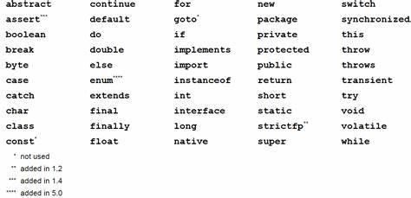
Java Keywords
Keywords or Reserved words are the words in a language that are used for some internal process or represent some predefined actions. These words are therefore not allowed to use as variable names or objects. If we do we will get a compile-time error

Slide 29
Introduction to Java
Self Assessment Questions
Select all of the following expressions that correctly associate a piece of data with their appropriate data type:
1.0 is an int
1.0 is a double
456 is an int
'd' is a char
"abcde" is a char;
"true" is a boolean;
Answer:

Slide 30
Introduction to Java
Document Links
Topics | URL | Notes
Datatypes | http://www.tutorialspoint.com/java/java_basic_datatypes.htm | This link provides detailed explanation of all datatypes with example.
Primitive and non primitive datatypes | https://www.newtutorialslab.com/2015/11/difference-between-primitive-and-non-primitive-data-type.html | This link provide difference between primitive and non primitive datatypes

Slide 31
Introduction to Java
Video Links
Topics | URL | Notes
Datatypes in java | https://www.youtube.com/watch?v=bqPIWlnjWbA | This videos explains about primitive and non primitive datatypes.

Slide 32
Introduction to Java
Operators in Java
An operator is a symbol that performs arithmetic operation.
An operator acts on some variables, called as operands to get the desired result.
Types of operators:
Arithmetic operator
Relational operator
Bitwise operator
Logical operator
Assignment operator
Ternary operator

Slide 33
Introduction to Java
Arithmetic operator
It is used to perform mathematical expression.
It takes numerical expression as their operands and return a single value as a result.
Operators | Symbol
Addition , Subtraction | + , -
Multiplication, Division | * , /
Modulus | %
Increment, Decrement | ++ , - -
Addition assignment | +=
Multiplication assignment | *=
Subtraction assignment | -=
Division assignment | /=
Modulus assignment | %=

Slide 34
Introduction to Java
Relational Operators:
Relational operators are used to check relation between two variables.
They are also used comparison operators since the outcome will be true or false.
Some of relational operators are:
Operators | Result
~ | Bitwise unary NOT
& | Bitwise AND
>> , << | Shift left, Shift right
>>=, <<= | Shift right assignment, shift left assignment
^ | Bitwise exclusive OR

Slide 35
Introduction to Java
Bitwise Operator
Binary operator treat their operands as a sequence of bits rather than as decimal, hexadecimal, or octal numbers.
For example: Decimal number 9 has a binary representation of 1001.
Java defines some bitwise operators that can be implemented to int ,long, short, char and byte.

Slide 36
Introduction to Java
Assignment operators
The assignment operators is the operator is the individual equals, =.
It’s general form is var = expression.
Operators | Name
= | Simple assignment operator.
+= | Add AND assignment operator
-= | Subtract AND assignment operator.
*= | Multiply AND assignment operator
/= | Divide AND assignment operator.

Slide 37
Introduction to Java
Logical operators
Logical operators are used to construct compound conditions. A compound condition is a combination of several simple conditions.
Logical operators are of three types:
&& and operator
| |or operator
not operator
Ternary operator
This operator is called ternary because it acts on 3 variables.
The other name for this operator is conditional operator, since it represents a conditional statement.
Its syntax is variable = expression l expression2 expression3.

Slide 38
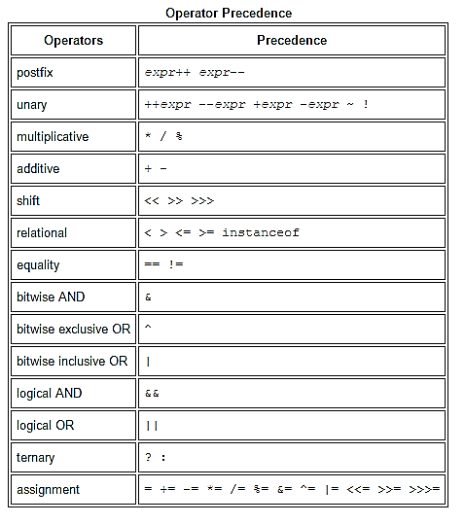
Introduction to Java
Operator Precedence
Operator precedence determines the order in which the operators in an expression are evaluated.

Slide 39
Introduction to Java
Self Assessment Questions
Which of these have highest precedence?
()
++
*
>>
Answer:

Slide 40
Introduction to Java
Self Assessment Questions
What should be expression1 evaluate to in using ternary operator as in this line? expression1 ? expression2 : expression3
Integer
Floating – point numbers
Boolean
None of the mentioned
Answer:

Slide 41
Introduction to Java
Self Assessment Questions
What should be expression1 evaluate to in using ternary operator as in this line? expression1 ? expression2 : expression3
Integer
Floating – point numbers
Boolean
None of the mentioned
Answer:

Slide 42
Introduction to Java
Document Links
Topics | URL | Notes
Operators in Java | https://data-flair.training/blogs/java-operators/ | This link explains about operators and its types.
Types of operators in Java | http://toolsqa.com/java/basic-java-programming/operators/ | This link explains types of operators with examples.
Operator precedence | https://www.programiz.com/java-programming/operator-precedence | This document will explain about operator precedence

Slide 43
Introduction to Java
Video Links
Topics | URL | Notes
Operators in Java | https://www.youtube.com/watch?v=TL7tdNp0raE | This video explains types of operators in java
Unary operators | https://www.youtube.com/watch?v=Ep_Qkcailrw | This video explains unary operators with examples
Operator precedence | https://www.youtube.com/watch?v=39i4JBKDKc8 | This video explains about operator precedence and associatively

